Slide 1
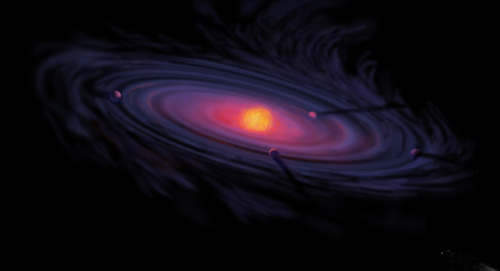
The Role of Ice Compositions and Disk Dynamics for Snowlines and C/N/O Ratios in Active Disks
Ana-Maria Piso^{1,2}
Karin Öberg², Ruth Murray-Clay³, Til Birnstiel^{2,5}, Jamila Pegues²
Inner Solar Systems: June 5th, 2017
¹UCLA, Earth, Planetary, and Space Sciences Department
²Harvard-Smithsonian Center for Astrophysics
³University of California Santa Barbara
⁴Steward Observatory, University of Arizona
⁵MPIA, Heidelberg

Slide 2
Fundamental Question
What composition will a formed giant planet have obtained?

Slide 3
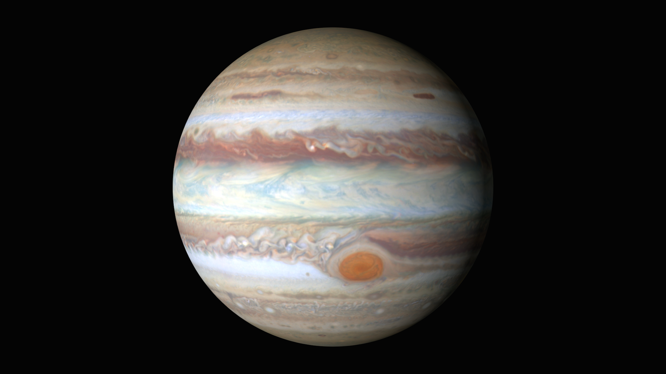
Gas Giants
Notes:
Picture of e.g. Jupiter and discuss why gas giants are important, and why we preferentially look at giant planets atmospheric spectra; there are also more problematic to form

Slide 4

Disk Compositions Regulate Planet Compositions
The composition of planets is determined by and tightly linked to the disk composition

Slide 5
Goal of this talk
The effect of disk structure and composition at different radii on the eventual composition of giant planets (Piso et al. 2015b, Piso et al. 2016)

Slide 6
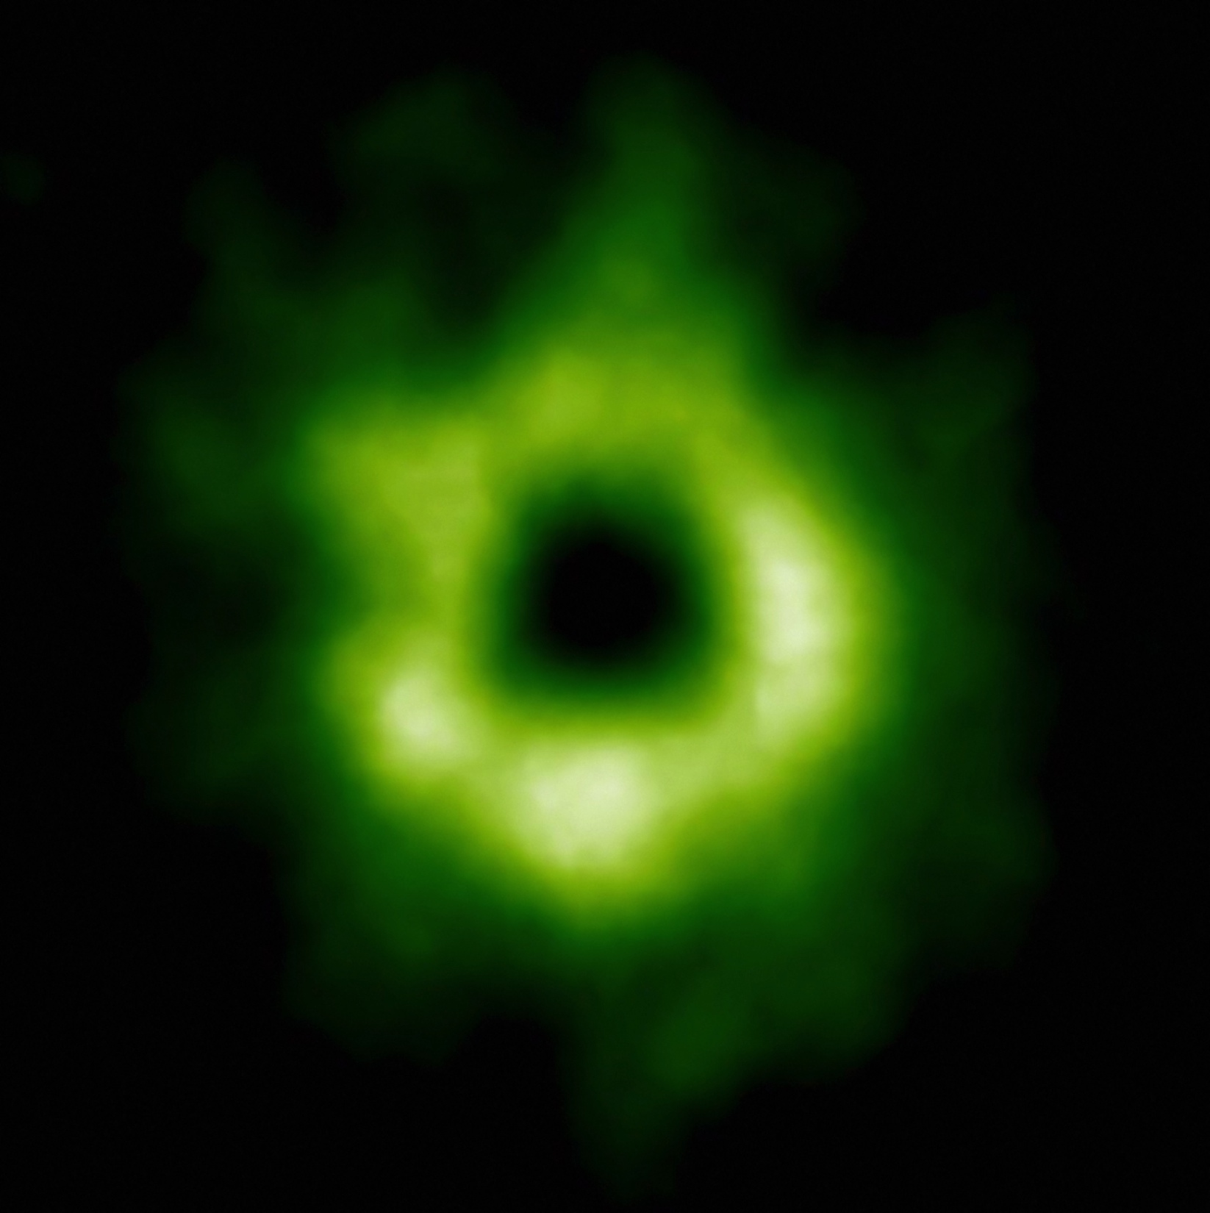
Snowline Locations in Protoplanetary Disks and C/N/O ratios
Notes:
Put the green TWHya figure instead.

Slide 7
BASIC IDEA
Understand the disk well enough to:
Predict what kind of planet compositions result from planet formation in different parts of the disk
Back-track the planet formation location based on the planet composition

Slide 8
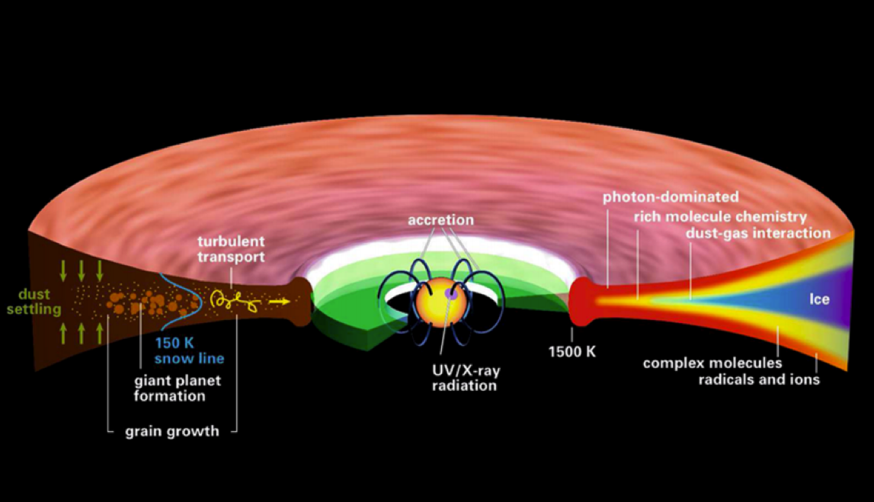
Disk structure is complex!
Henning&Semenov (2013)
Notes:
Remove the while and make the figure bigger.

Slide 9
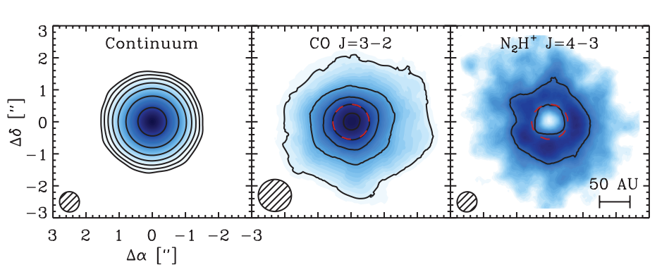
Snowlines of volatile molecules have been detected in disks
Qi+13

Slide 10
More volatile snowlines in disks
Adapted from Piso, Pegues, Oberg (2016)

Slide 11
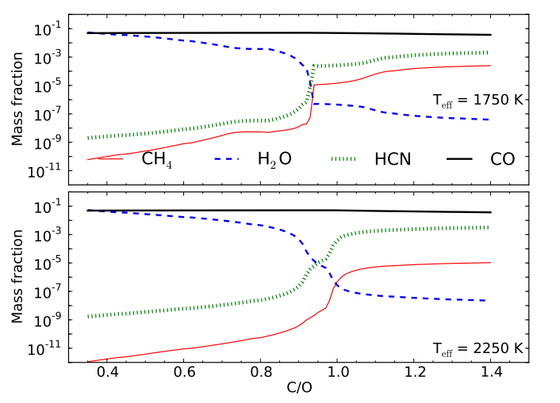
C/O ratio is an important signature of atmospheric chemistry
Molliere+15

Slide 12
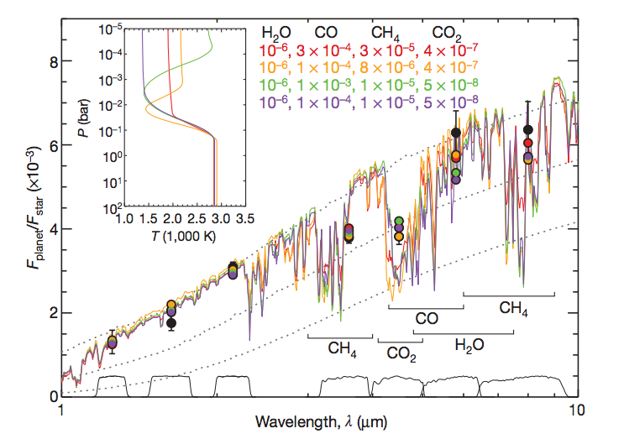
Some giant planets may have C/O ratios different from the stellar value of 0.54
Madhusudhan+11
Notes:
Show a slide before this with model predictions. Arxiv paper by katherine lodders.2009 figure 1.8

Slide 13
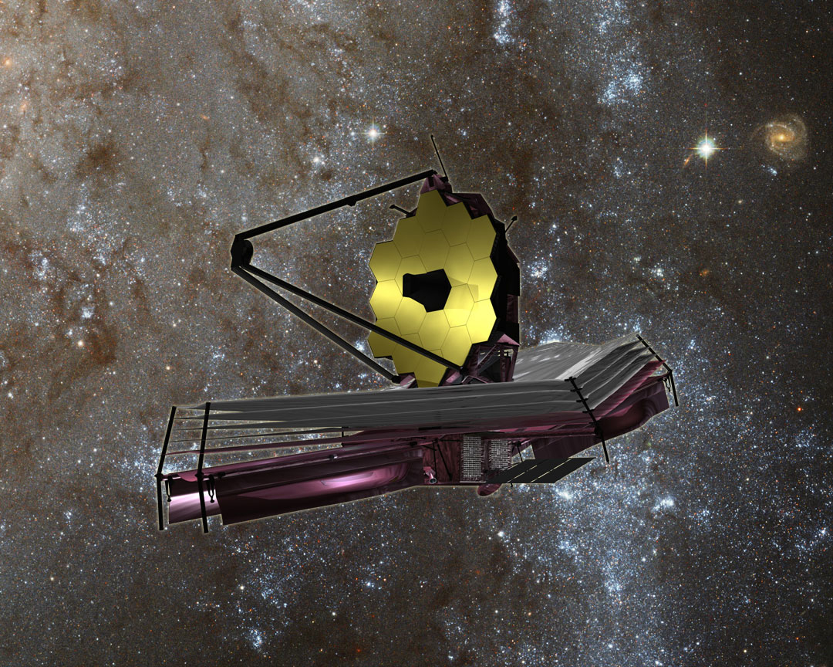
nasa.gov

Slide 14
WHY Different C/O Ratios?
Possible explanation: main carriers of C and O, i.e. H₂O, CO₂ and CO, have different condensation temperatures => variations in the abundances of C and O in solids and gas between the snow lines of these volatiles

Slide 15
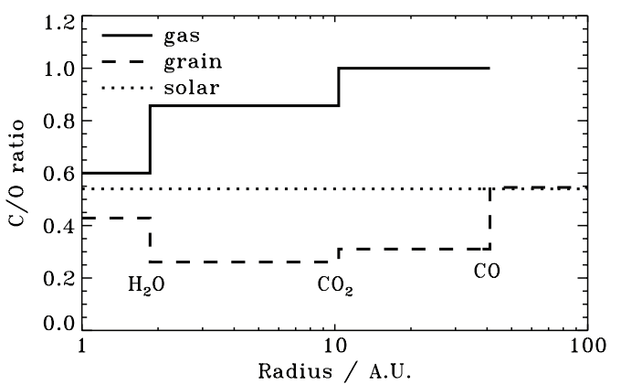
Oberg, Murray-Clay, Bergin (2011)
After Oberg+11

Slide 16
Understand how radial drift, gas accretion and ice morphology affect snowline locations, and thus the C/O ratio in gas and dust throughout the disk
GOAL

Slide 17
Radial drift of solids
Gas moves at sub-Keplerian velocity:
v_{gas} ~ v_{K} (1-c_{s}² / v_{k}²)
Small particles (~micron size) move with the gas
Large particles (~km size) are unaffected by gas drag
“Intermediate sized” particles (~cm-m size) experience a headwind and drift towards the star

Slide 18
Timescales for desorption, radial drift and gas accretion ARE comparable
Piso, Oberg, Birnstiel, Murray-Clay (2015)

Slide 19
We determined upper limits for the C/O ratio across the disk
Piso, Oberg, Birnstiel, Murray-Clay (2015)

Slide 20
Ice Morphology
The binding energies of CO varies by a factor of ~1.7 depending on whether CO is pure or water dominated ice
Adapted from Fayolle+16

Slide 21
Disk dynamics and ice morphology may change the CO snowline location by a factor of 7!
Piso, Pegues, Oberg (2016)
Notes:
Split in 2 slides; talk about N/O, then next slide say the same holds true for C/O

Slide 22
Disk dynamics and ice morphology may change the CO snowline location by a factor of 7!
H₂O
CO₂
CO
Piso, Pegues, Oberg (2016)
Notes:
Split in 2 slides; talk about N/O, then next slide say the same holds true for C/O

Slide 23
Disk dynamics and ice morphology may change the CO snowline location by a factor of 7!
H₂O
CO₂
CO
Disk dynamics
=> factor of ~2
Piso, Pegues, Oberg (2016)
Notes:
Split in 2 slides; talk about N/O, then next slide say the same holds true for C/O

Slide 24
Disk dynamics and ice morphology may change the CO snowline location by a factor of 7!
H₂O
CO₂
CO
Disk dynamics
=> factor of ~2
Ice morphology
=> factor of ~3-4
Piso, Pegues, Oberg (2016)
Notes:
Split in 2 slides; talk about N/O, then next slide say the same holds true for C/O

Slide 25
Disk dynamics and ice morphology may change the CO snowline location by a factor of 7!
H₂O
CO₂
CO
Disk dynamics
=> factor of ~2
Ice morphology
=> factor of ~3-4
CO snowlines span 9-61 AU!
Piso, Pegues, Oberg (2016)
Notes:
Split in 2 slides; talk about N/O, then next slide say the same holds true for C/O

Slide 26
N/O ratios in static disks: highly enhanced gas N/O compared to the average value
Piso, Pegues, Oberg (2016)
Notes:
1) Focus on NH3 abundance, even with max NH3 still have enhanced N/O; block out bottom 2 panels first to talk about N/O

Slide 27
Disk dynamics and ice morphology may change the N₂ snowline locations by a factor of 7!
H₂O
CO₂
CO
N₂
N₂ snowlines span 11-79 AU!
Piso, Pegues, Oberg (2016)
Notes:
Split in 2 slides; talk about N/O, then next slide say the same holds true for C/O

Slide 28
Takeaway point 1: Gas phase N/O ratios are highly enhanced throughout most of the disk compared to the average value, and more enhanced than the C/O ratio
Takeaway point 2: The locations of the CO and N₂ snowlines are highly uncertain and can span several tens of AU due to disk dynamics and ice morphology => observations are KEY

Slide 31
NEXT STEPS
Henning&Semenov (2013)

Slide 32
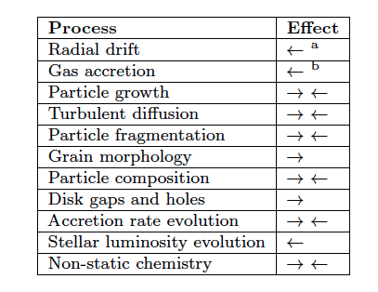
Additional chemical and dynamical processes to be explored
Piso, Oberg, Birnstiel, Murray-Clay (2015)
Piso+15
Notes:
Outline diffusion and chemistry

Slide 33
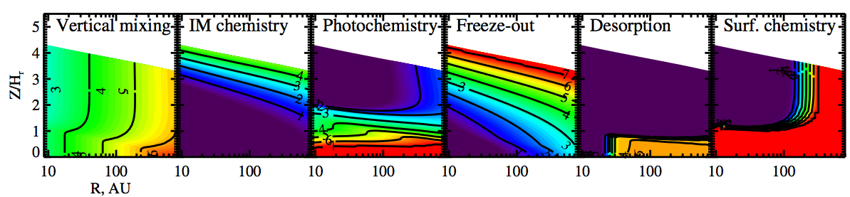
Chemistry and Dynamics need to be coupled
Semenov & Wiebe (2011)

Slide 34
Fundamental Questions
Where in the disk can giant planets form?
Piso & Youdin (2014)
Piso, Youdin, & Murray-Clay (2015)
2. What compositions will the formed giant planets have obtained?
Piso, Öberg, Birnstiel, & Murray-Clay (2015)
Piso, Pegues, & Öberg (2016)
Notes:
Write all authors

Slide 35
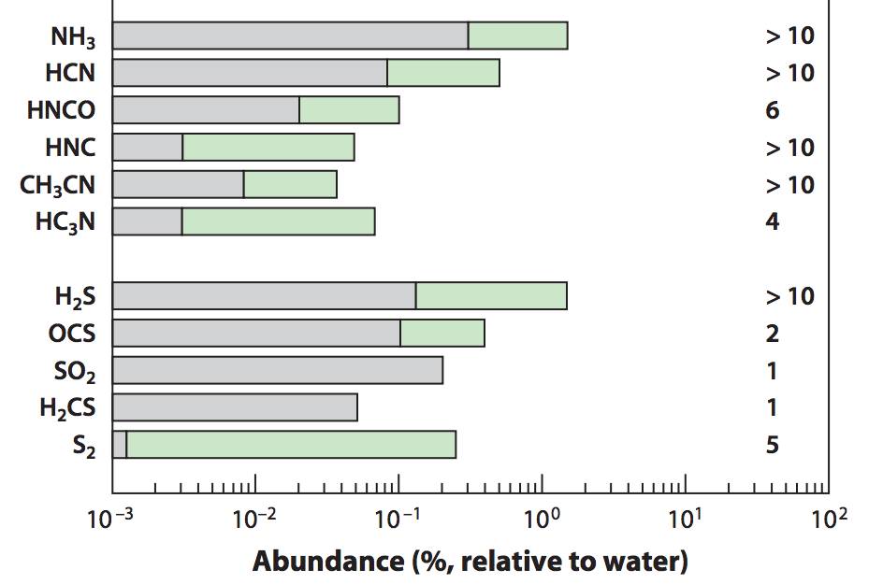
Nitrogen is important!
Add nitrogen-bearing molecules – nitrogen highly abundant in the Solar System and in disks and primarily found as N₂
Some N present in the form of NH₃
=> Use the median and maximum NH₃ abundances observed in protostellar cores from Spitzer c2d Legacy ice survey (Oberg et al. 2008, Oberg et al. 2011, etc.)
Mumma&Charnley(2011)
Notes:
Separate in two slides
Mention NH3 most abundant nitrogen carrier, bot low percentage of total N abundance => the rest in N2
Ice spectra or table
Show desorption curves from Edith’s paper

Slide 36
Radial drift affects snowline location
Irradiated disk
Evolving disk
Piso, Oberg, Birnstiel, Murray-Clay (2015)

Slide 37
The desorption distance for transition disks agrees with observations
Piso, Oberg, Birnstiel, Murray-Clay (2015)
Notes:
Cite TWHya paper

